Slide 1
Operating system overview
Module-1

Slide 2
Introduction to operating system
An operating system is a system software which manages, operates and communicates with the computer hardware and software.
To complete the execution user program needs many resources.
The main job of operating system is to provide resources and services to the user program.

Slide 3
Definition:
An operating system acts as an interface between the user and hardware of the computer and also controls the execution of application programs.
Operating system also called as resource manager.

Slide 4
Need of operating system
Basically operating system performs tasks like identifying input from input devices and sending output to output devices.
User’s program should get the processing unit to complete the execution.
Memory is to be allocated to user program as per need.

Slide 5
Operating system objectives
Convenience
computer system can be conveniently used due to operating system
Efficiency
computer system comprises of many resources. All these resources are utilized by user’s applications in efficient manner
Ability to evolve
The design of the OS permits the efficient development, testing.

Slide 6
Functions of operating system
1. Process Management
2. Memory Management
3. File Management
4. Device Management
5. Protection and security
6. User Interface
7. Booting the computer
8. Performs basic computer tasks

Slide 7
Process Management
Provide controlled access to shared resources
Execution of user applications
User and system process management
Resume or cancel process execution
Process scheduling
Synchronization, interprocess communication and deadlock handling.

Slide 8
Memory management
Allocates primary and secondary memory to the user and system processes.
Reclaim resources from completed processes
Monitoring and tracking of used memory by processes.

Slide 9
File management
File and directory management
Backup of files
Security for files
Services to access and store files

Slide 10
Device management
Managing device drivers
Track device drivers to communicate and control

Slide 11
Protection and security
Protecting resources
Uses authentication and file attributes to provide security

Slide 12
User interface
Os acts as an interface between the user and the computer hardware. This interface is offered through set of commands or GUI.

Slide 13
Booting the computer
The process of starting or restarting the computer is known as booting
Cold booting
Warm booting

Slide 14
Performs basic computer tasks
Managing peripheral devices
Plug and play OS

Slide 15
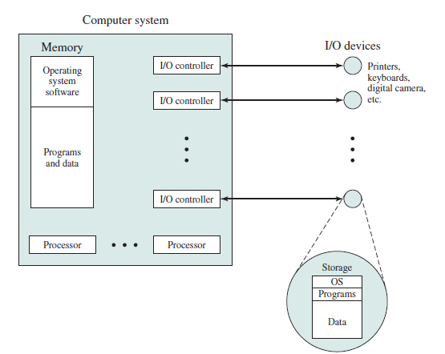
The Operating System as Resource Manager

Slide 16
Figure suggests the main resources that are managed by the OS.
A portion of the OS is in main memory. This includes the kernel , or nucleus , which contains the most frequently used functions in the OS and, at a given time, other portions of the OS currently in use.
The remainder of main memory contains user programs and data.
The memory management hardware in the processor and the OS jointly
control the allocation of main memory.
The OS decides when an I/O device can be used by a program in execution and controls access to and use of files.
The processor itself is a resource, and the OS must determine how much processor time is to be devoted to the execution of a particular user program.
In the case of a multiple-processor system, this decision must span all of the processors.

Slide 17
Ease of Evolution of an Operating System
A major OS will evolve over time for a number of reasons:
Hardware upgrades plus new types of hardware:
For example, early versions of UNIX and the Macintosh OS did not employ a paging mechanism because they were run on processors without paging hardware. Subsequent versions of these operating systems were modified to exploit paging capabilities.
Also, the use of graphics terminals and page-mode terminals instead of line-at-a-time scroll mode terminals affects OS design. For example, a graphics terminal typically allows the user to view several applications at the same time through “windows” on the screen. This requires more sophisticated support in the OS.

Slide 18
New services:
In response to user demand or in response to the needs of system managers, the OS expands to offer new services. For example, if it is found to be difficult to maintain good performance for users with existing tools, new measurement and control tools may be added to the OS.
Fixes:
Any OS has faults. These are discovered over the course of time and fixes are made. Of course, the fix may introduce new faults.

Slide 19
THE EVOLUTION OF OPERATING SYSTEMS
Serial Processing
With the earliest computers, from the late 1940s to the mid-1950s, the programmer interacted directly with the computer hardware; there was no OS. These computers were run from a console consisting of display lights, toggle switches, some form of input device, and a printer. Programs in machine code were loaded via the input device (e.g., a card reader).
If an error halted the program, the error condition was indicated by the lights.
If the program proceeded to a normal completion, the output appeared on the printer.

Slide 20
These early systems presented two main problems:
Scheduling: Most installations used a hardcopy sign-up sheet to reserve computer time. Typically, a user could sign up for a block of time in multiples of a half hour or so.
Setup time: A single program, called a job , could involve loading the compiler plus the high-level language program (source program) into memory, saving the compiled program (object program) and then loading and linking together the object program and common functions. Each of these steps could involve mounting or dismounting tapes or setting up card decks.
This mode of operation could be termed serial processing , reflecting the fact that users have access to the computer in series. Over time, various system software tools were developed to attempt to make serial processing more efficient.

Slide 21
Simple Batch Systems
Early computers were very expensive, and therefore it was important to maximize processor utilization.
To improve utilization, the concept of a batch OS was developed. It appears that the first batch OS (and the first OS of any kind) was developed in the mid-1950s by General Motors for use on an IBM 701 [WEIZ81]. By the early 1960s, a number of vendors had developed batch operating systems for their computer systems.
The central idea behind the simple batch-processing scheme is the use of a piece of software known as the monitor . With this type of OS, the user no longer has direct access to the processor. Instead, the user submits the job on cards or tape to a computer operator, who batches the jobs together sequentially and places the entire batch on an input device, for use by the monitor.

Slide 22
To understand how this scheme works, let us look at it from two points of view: that of the monitor and that of the processor.
Monitor point of view: The monitor controls the sequence of events. For this to be so, much of the monitor must always be in main memory and available for execution ( Figure 2.3 ). That portion is referred to as the resident monitor .
The rest of the monitor consists of utilities and common functions that are loaded as subroutines to the user program at the beginning of any job that requires them.
The monitor reads in jobs one at a time from the input device (typically a card reader or magnetic tape drive). As it is read in, the current job is placed in the user program area, and control is passed to this job.
When the job is completed, it returns control to the monitor, which immediately reads in the next job. The results of each job are sent to an output device, such as a printer, for delivery to the user.

Slide 24
The monitor performs a scheduling function: A batch of jobs is queued up, and jobs are executed as rapidly as possible, with no intervening idle time. The monitor improves job setup time as well.
With each job, instructions are included in a primitive form of job control language (JCL) . This is a special type of programming language used to provide instructions to the monitor.
A simple example is that of a user submitting a program written in the programming language FORTRAN plus some data to be used by the program. All FORTRAN instructions and data are on a separate punched card or a separate record on tape.
In addition to FORTRAN and data lines, the job includes job control instructions, which are denoted by the beginning $.

Slide 25
The overall format of the job looks like this:

Slide 26
To execute this job, the monitor reads the $FTN line and loads the appropriate language compiler from its mass storage (usually tape). The compiler translates the user’s program into object code, which is stored in memory or mass storage.
If it is stored in memory, the operation is referred to as “compile, load, and go.” If it is stored on tape, then the $LOAD instruction is required. This instruction is read by the monitor, which regains control after the compile operation.
During the execution of the user program, any input instruction causes one line of data to be read. The input instruction in the user program causes an input routine that is part of the OS to be invoked. The input routine checks to make sure that the program does not accidentally read in a JCL line. If this happens, an error occurs and control transfers to the monitor. At the completion of the user job, the monitor will scan the input lines until it encounters the next JCL instruction.
Thus, the system is protected against a program with too many or too few data lines.

Slide 27
The monitor, or batch OS, is simply a computer program. It relies on the ability of the processor to fetch instructions from various portions of main memory to alternately seize and relinquish control. Certain other hardware features are also desirable:
Memory protection: While the user program is executing, it must not alter the memory area containing the monitor. If such an attempt is made, the processor hardware should detect an error and transfer control to the monitor. The monitor would then abort the job, print out an error message, and load in the next job.
Timer: A timer is used to prevent a single job from monopolizing the system. The timer is set at the beginning of each job. If the timer expires, the user program is stopped, and control returns to the monitor.

Slide 28
Privileged instructions: Certain machine level instructions are designated privileged and can be executed only by the monitor. If the processor encounters such an instruction while executing a user program, an error occurs causing control to be transferred to the monitor.
Among the privileged instructions are I/O instructions, so that the monitor retains control of all I/O devices.
This prevents, for example, a user program from accidentally reading job control instructions from the next job. If a user program wishes to perform I/O, it must request that the monitor perform the operation for it.

Slide 29
Interrupts: Early computer models did not have this capability. This feature gives the OS more flexibility in relinquishing control to and regaining control from user programs. Considerations of memory protection and privileged instructions lead to the concept of modes of operation.
user mode -in which certain areas of memory are protected from the user’s use and in which certain instructions may not be executed.
kernel mode- , in which privileged instructions may be executed and in which protected areas of memory may be accessed.
With a batch OS, processor time alternates between execution of user programs and execution of the monitor. There have been two sacrifices:
Some main memory is now given over to the monitor and some processor time is consumed by the monitor. Both of these are forms of overhead.
Despite this overhead, the simple batch system improves utilization of the computer.

Slide 30

Multiprogrammed Batch Systems
Even with the automatic job sequencing provided by a simple batch OS, the processor is often idle. The problem is that I/O devices are slow compared to the processor.
Figure 2.5a illustrates this situation, where we have a single program, referred to as uniprogramming. The processor spends a certain amount of time executing, until it reaches an I/O instruction.

Slide 31
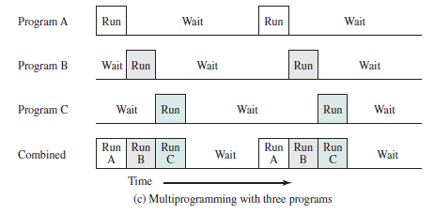
Suppose that there is room for the OS and two user programs. When one job needs to wait for I/O, the processor can switch to the other job, which is likely not waiting for I/O.
Furthermore, we might expand memory to hold three, four, or more programs and switch among all of them ( Figure 2.5c ). The approach is known as multiprogramming , or multitasking . It is the central theme of modern operating systems.

Slide 32
Time-Sharing Systems
With the use of multiprogramming, batch processing can be quite efficient. However, for many jobs, it is desirable to provide a mode in which the user interacts directly with the computer. Indeed, for some jobs, such as transaction processing, an interactive mode is essential.
Just as multiprogramming allows the processor to handle multiple batch jobs at a time, multiprogramming can also be used to handle multiple interactive jobs. In this latter case, the technique is referred to as time sharing , because processor time is shared among multiple users.
In a time-sharing system, multiple users simultaneously access the system through terminals, with the OS interleaving the execution of each user program in a short burst or quantum of computation.
Thus, if there are n users actively requesting service at one time, each user will only see on the average 1/ n of the effective computer capacity, not counting OS overhead.

Slide 33
Operating-System Structure
A system as large and complex as a modern operating system must be engineered carefully if it is to function properly and be modified easily.
A common approach is to partition the task into small components, or modules, rather than have one monolithic system.
Each of these modules should be a well-defined portion of the system, with carefully defined inputs, outputs, and functions.

Slide 34
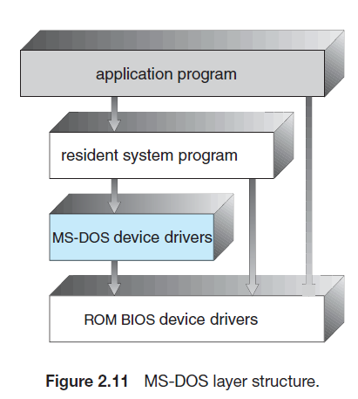
Many operating systems do not have well-defined structures. MS-DOS is an example of such a system. It was originally designed and implemented by a few people who had no idea that it would become so popular. It was written to provide the most functionality in the least space, so it was not carefully divided into modules. Figure 2.11 shows its structure.

Slide 35
In MS-DOS, the interfaces and levels of functionality are not well separated. For instance, application programs are able to access the basic I/O routines to write directly to the display and disk drives.
Such freedom leaves MS-DOS vulnerable to errant (or malicious) programs, causing entire system crashes when user programs fail.
Of course, MS-DOS was also limited by the hardware of its era. Because the Intel 8088 for which it was written provides no dual mode and no hardware protection, the designers of MS-DOS had no choice but to leave the base hardware accessible.

Slide 36
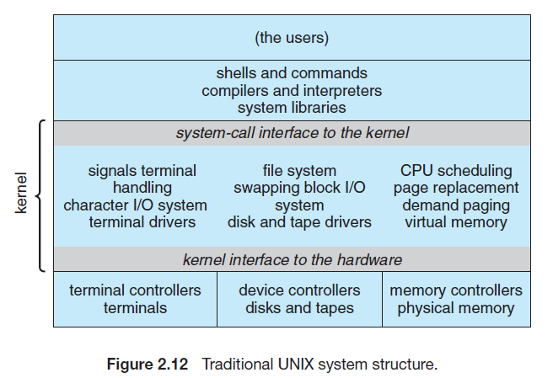
Another example of limited structuring is the original UNIX operating system. Like MS-DOS, UNIX initially was limited by hardware functionality.
It consists of two separable parts: the kernel and the system programs. The kernel is further separated into a series of interfaces and device drivers, which have been added and expanded over the years as UNIX has evolved.
We can view the traditional UNIX operating system as being layered to some extent, as shown in Figure 2.12.

Slide 37
Everything below the system-call interface and above the physical hardware is the kernel. The kernel provides the file system, CPU scheduling, memory management, and other operating-system functions through system calls. Taken in sum, that is an enormous amount of functionality to be combined into one level.
This monolithic structure was difficult to implement and maintain. It had a distinct performance advantage, however: there is very little overhead in the system call interface or in communication within the kernel. We still see evidence of this simple, monolithic structure in the UNIX, Linux, and Windows operating systems.

Slide 38
Layered Approach
With proper hardware support, operating systems can be broken into pieces that are smaller and more appropriate than those allowed by the original MS-DOS and UNIX systems.
Under a topdown approach, the overall functionality and features are determined and are separated into components.
A system can be made modular in many ways. One method is the layered approach, in which the operating system is broken into a number of layers (levels).
The bottom layer (layer 0) is the hardware; the highest (layer N) is the user interface. This layering structure is depicted in Figure 2.13.

Slide 39
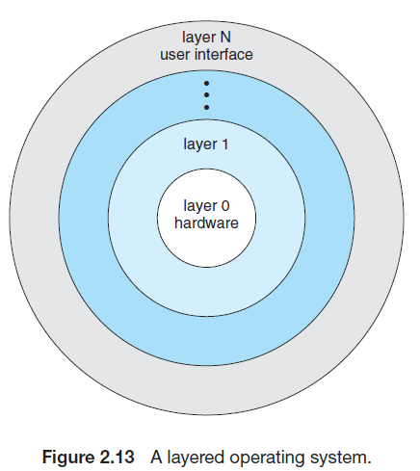

Slide 40
An operating-system layer is an implementation of an abstract object made up of data and the operations that can manipulate those data. A typical operating-system layer—say, layer M—consists of data structures and a set of routines that can be invoked by higher-level layers. Layer M, in turn, can invoke operations on lower-level layers.
The main advantage of the layered approach is simplicity of construction and debugging. The layers are selected so that each uses functions (operations) and services of only lower-level layers. This approach simplifies debugging and system verification.
The first layer can be debugged without any concern for the rest of the system, because, by definition, it uses only the basic hardware (which is assumed correct) to implement its functions. Once the first layer is debugged, its correct functioning can be assumed while the second layer is debugged, and so on.
If an error is found during the debugging of a particular layer, the error must be on that layer, because the layers below it are already debugged. Thus, the design and implementation of the system are simplified.
Each layer is implemented only with operations provided by lower-level layers. A layer does not need to know how these operations are implemented; it needs to know only what these operations do.
Hence, each layer hides the existence of certain data structures, operations, and hardware from higher-level layers.

Slide 41
The major difficulty with the layered approach involves appropriately defining the various layers. Because a layer can use only lower-level layers, careful planning is necessary. For example, the device driver for the backing store (disk space used by virtual-memory algorithms) must be at a lower level than the memory-management routines, because memory management requires the ability to use the backing store.
The backing-store driver would normally be above the CPU scheduler, because the driver may need to wait for I/O and the CPU can be rescheduled during this time. However, on a large system, the CPU scheduler may have more information about all the active processes than can fit in memory. Therefore, this information may need to be swapped in and out of memory, requiring the backing-store driver routine to be below the CPU scheduler.
A final problem with layered implementations is that they tend to be less efficient than other types. For instance, when a user program executes an I/O operation, it executes a system call that is trapped to the I/O layer, which calls the memory-management layer, which in turn calls the CPU-scheduling layer, which is then passed to the hardware.

Slide 42
At each layer, the parameters may be modified, data may need to be passed, and so on. Each layer adds overhead to the system call. The net result is a system call that takes longer than does one on a nonlayered system.
These limitations have caused a small backlash against layering in recent years. Fewer layers with more functionality are being designed, providing most of the advantages of modularized code while avoiding the problems of layer definition and interaction.

Slide 43
Microkernels
We have already seen that as UNIX expanded, the kernel became large and difficult to manage.
In the mid-1980s, researchers at Carnegie Mellon University developed an operating system called Mach that modularized the kernel using the microkernel approach.
This method structures the operating system by removing all nonessential components from the kernel and implementing them as system and user-level programs.
The result is a smaller kernel. There is little consensus regarding which services should remain in the kernel and which should be implemented in user space.
Typically, however, microkernels provide minimal process and memory management, in addition to a communication facility. Figure 2.14 illustrates the architecture of a typical microkernel.

Slide 44
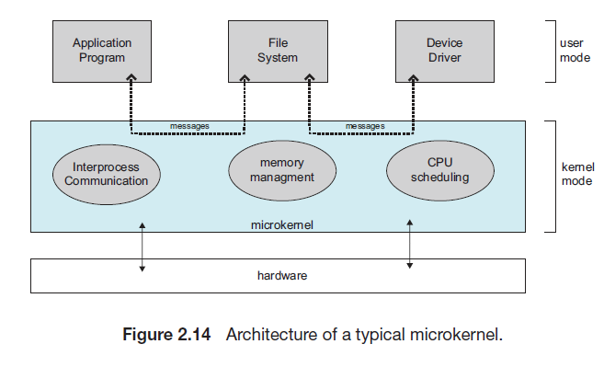

Slide 45
The main function of the microkernel is to provide communication between the client program and the various services that are also running in user space.
Communication is provided through message passing. For example, if the client program wishes to access a file, it must interact with the file server. The client program and service never interact directly. Rather, they communicate indirectly by exchanging messages with the microkernel.
One benefit of the microkernel approach is that it makes extending the operating system easier. All new services are added to user space and consequently do not require modification of the kernel.
When the kernel does have to be modified, the changes tend to be fewer, because the microkernel is a smaller kernel. The resulting operating system is easier to port from one hardware design to another.
The microkernel also provides more security and reliability, since most services are running as user—rather than kernel—processes. If a service fails, the rest of the operating system remains untouched.

Slide 46
Unfortunately, the performance of microkernels can suffer due to increased system-function overhead.
Consider the history of Windows NT. The first release had a layered microkernel organization. This version’s performance was low compared with that of Windows 95.
Windows NT 4.0 partially corrected the performance problem by moving layers from user space to kernel space and integrating them more closely.
By the time Windows XP was designed, Windows architecture had become more monolithic than microkernel.

Slide 47
Modules
Perhaps the best current methodology for operating-system design involves using loadable kernel modules.
Here, the kernel has a set of core components and links in additional services via modules, either at boot time or during run time.
This type of design is common in modern implementations of UNIX, such as Solaris, Linux, and Mac OS X, as well as Windows.
The idea of the design is for the kernel to provide core services while other services are implemented dynamically, as the kernel is running.
Linking services dynamically is preferable to adding new features directly to the kernel, which would require recompiling the kernel every time a change was made.
Thus, for example, we might build CPU scheduling and memory management algorithms directly into the kernel and then add support for different filesystems by way of loadable modules.

Slide 48
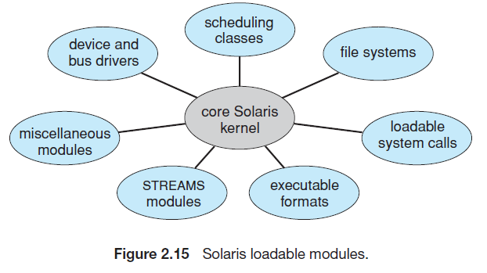
The overall result resembles a layered system in that each kernel section has defined, protected interfaces; but it is more flexible than a layered system, because any module can call any other module.
The approach is also similar to the microkernel approach in that the primary module has only core functions and knowledge of how to load and communicate with other modules; but it is more efficient, because modules do not need to invoke message passing in order to communicate.
The Solaris operating system structure, shown in Figure 2.15, is organized around a core kernel with seven types of loadable kernel modules:

Slide 49
Hybrid Systems
In practice, very few operating systems adopt a single, strictly defined structure. Instead, they combine different structures, resulting in hybrid systems that address performance, security, and usability issues.
For example, both Linux and Solaris are monolithic, because having the operating system in a single address space provides very efficient performance. However, they are also modular, so that new functionality can be dynamically added to the kernel.
Windows is largely monolithic as well (again primarily for performance reasons), but it retains some behavior typical of microkernel systems, including providing support for separate subsystems (known as operating-system personalities) that run as user-mode processes.
we explore the structure of three hybrid systems: the Apple Mac OS X operating system and the two most prominent mobile operating systems—iOS and Android.

Slide 50
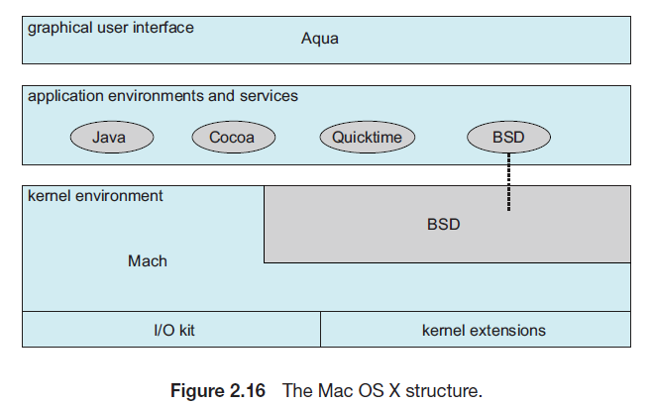
Mac OS X
The Apple Mac OS X operating system uses a hybrid structure. As shown in Figure 2.16, it is a layered system.

Slide 51
The top layers include the Aqua user interface and a set of application environments and services.
Below these layers is the kernel environment, which consists primarily of the Mach microkernel and the BSD UNIX kernel.
Mach provides memory management; support for remote procedure calls (RPCs) and interprocess communication (IPC) facilities, including message passing; and thread scheduling.
The BSD component provides a BSD command-line interface, support for networking and file systems, and an implementation of POSIX APIs, including Pthreads.
In addition to Mach and BSD, the kernel environment provides an I/O kit for development of device drivers and dynamically loadable modules (which Mac OS X refers to as kernel extensions).
The BSD application environment can make use of BSD facilities directly.
The bottom layer represents the core operating system, which is based on the kernel environment shown in Figure 2.16.

Slide 52
Android
The Android operating system was designed by the Open Handset Alliance (led primarily by Google) and was developed for Android smartphones and tablet computers.
Whereas iOS is designed to run on Apple mobile devices and is close-sourced, Android runs on a variety of mobile platforms and is open-sourced, partly explaining its rapid rise in popularity.
Android is similar to iOS in that it is a layered stack of software that provides a rich set of frameworks for developing mobile applications.
At the bottom of this software stack is the Linux kernel, although it has been modified by Google and is currently outside the normal distribution of Linux releases.
The structure of Android appears in Figure 2.18.

Slide 53
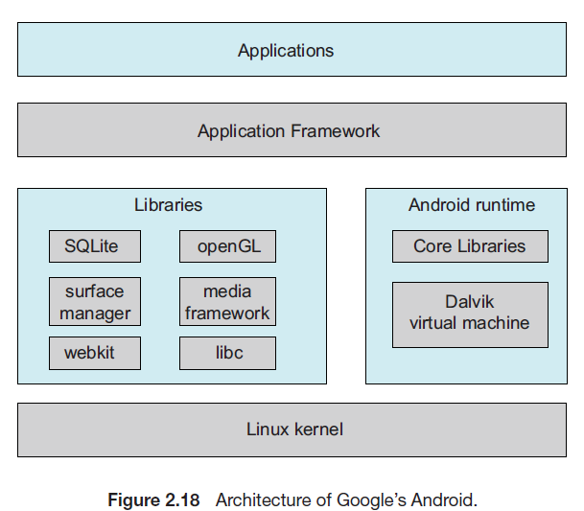

Slide 54
Linux is used primarily for process, memory, and device-driver support for hardware and has been expanded to include power management.
The Android runtime environment includes a core set of libraries as well as the Dalvik virtual machine.
Software designers for Android devices develop applications in the Java language. However, rather than using the standard Java API, Google has designed a separate Android API for Java development.
The Java class files are first compiled to Java bytecode and then translated into an executable file that runs on the Dalvik virtual machine.
The Dalvik virtual machine was designed for Android and is optimized for mobile devices with limited memory and CPU processing capabilities.
The set of libraries available for Android applications includes frameworks for developing web browsers (webkit), database support (SQLite), and multimedia.
The libc library is similar to the standard C library but is much smaller and has been designed for the slower CPUs that characterize mobile devices.

Slide 55
Linux kernel and shell
Design Principles of Linux
The design of linux looks like any other traditional, non-microkernel UNIX implementation.
It is multiuser, multitasking system consisting of Unix compatible tools.
The file system of Linux sticks on traditional Unix semantics. Linux also completely implements standard unix networking model.
From the beginning of the design, Linux tried to acquire as much functionality as possible from limited rsources.
With the enhancement in machine configuration and efficiency , Linux kernel grew to implement more Unix functionality.

Slide 56
Thus, although Linux may be considered monolithic, its modular structure overcomes some of the difficulties in developing and evolving the kernel.
The Linux loadable modules have two important characteristics:
• Dynamic linking:
A kernel module can be loaded and linked into the kernel while the kernel is already in memory and executing. A module can also be unlinked and removed from memory at any time.
• Stackable modules:
The modules are arranged in a hierarchy. Individual modules serve as libraries when they are referenced by client modules higher up in the hierarchy, and as clients when they reference modules further down.

Slide 57
Dynamic linking facilitates configuration and saves kernel memory.
In Linux, a user program or user can explicitly load and unload kernel modules using the insmod and rmmod commands.
The kernel itself monitors the need for particular functions and can load and unload modules as needed.
With stackable modules, dependencies between modules can be defined. This has two benefits:
1. Code common to a set of similar modules (e.g., drivers for similar hardware) can be moved into a single module, reducing replication.
2. The kernel can make sure that needed modules are present, refraining from unloading a module on which other running modules depend, and loading any additional required modules when a new module is loaded.

Slide 58
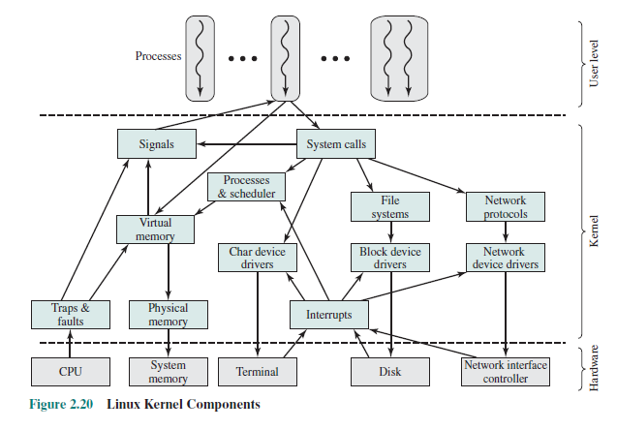
Kernel Components

Slide 59
Figure 2.20 , shows the main components of the Linux kernel as implemented on an IA-64 architecture (e.g., Intel Itanium).
The figure shows several processes running on top of the kernel. Each box indicates a separate process, while each squiggly line with an arrowhead represents a thread of execution.
The kernel itself consists of an interacting collection of components, with arrows indicating the main interactions. The underlying hardware is also depicted as a set of components with arrows indicating which kernel components use or control which hardware components.
All of the kernel components, of course, execute on the processor but, for simplicity, these relationships are not shown.

Slide 60
Briefly, the principal kernel components are the following:
• Signals:
The kernel uses signals to call into a process. For example, signals are used to notify a process of certain faults, such as division by zero.
• System calls:
The system call is the means by which a process requests a specific kernel service. There are several hundred system calls, which can be roughly grouped into six categories: file system, process, scheduling, interprocess communication, socket (networking), and miscellaneous.
• Processes and scheduler:
Creates, manages, and schedules processes.
• Virtual memory:
Allocates and manages virtual memory for processes.

Slide 61
• File systems: Provides a global, hierarchical namespace for files, directories, and other file related objects and provides file system functions.
• Network protocols: Supports the Sockets interface to users for the TCP/IP protocol suite.
• Character device drivers: Manages devices that require the kernel to send or receive data one byte at a time, such as terminals, modems, and printers.
• Block device drivers: Manages devices that read and write data in blocks, such as various forms of secondary memory (magnetic disks, CD-ROMs, etc.).
• Network device drivers: Manages network interface cards and communications ports that connect to network devices, such as bridges and routers.
• Traps and faults: Handles traps and faults generated by the processor, such as a memory fault.
• Physical memory: Manages the pool of page frames in real memory and allocates pages for virtual memory.
• Interrupts: Handles interrupts from peripheral devices.

Slide 62
Shell
A user interface is provided by program called as shell.
Users can type in commands and run programs on a Unix system with a shell.
Shell reads in from the terminal the typed command by user, run these commands and display the output of the commands.
User can write programs using the C shell and these programs are called shell scripts.
The shell has its own restricted capabilities. If we use it as a “glue” language to combine the standard Unix utilities and custom software, then useful tool can be realized instead of using component parts alone.
A shell script can be written by using any shell. For this every first line in script is #!/pathtoshell
A input to a shell can be a any file by using the syntax:ksh myscript.

Slide 63
A shell script is a simple sequence of commands that user often types. If we put them into a script, it can be reduced to a single command. Sh – bourne shell, csh – the C shell, are examples of different shells.
Linux offers GUI but still it offer the facility of shell as many programmers and users prefer to use it. The CLI is called the shell.
When the shell starts up, it initializes itself, then types a prompt character on the screen and waits for the user to input a command.
When the user gives input command, the shell removes the first character from it.
Then it assumes that as the name of the program to be run. Then it finds that program and runs it.

Slide 64
System calls
System calls provide an interface to the services made available by an operating system. These calls are generally available as routines written in C and C++, although certain low-level tasks (for example, tasks where hardware must be accessed directly) may have to be written using assembly-language instructions.
let’s first use an example to illustrate how system calls are used: writing a simple program to read data from one file and copy them to another file.
The first input that the program will need is the names of the two files: the input file and the output file. These names can be specified I nmany ways, depending on the operating-system design.
One approach is for the program to ask the user for the names. In an interactive system, this approach will require a sequence of system calls, first to write a prompting message on the screen and then to read from the keyboard the characters that define the two files.
On mouse-based and icon-based systems, a menu of file names is usually displayed in a window. The user can then use the mouse to select the source name, and a window can be opened for the destination name to be specified. This sequence requires many I/O system calls.

Slide 65
Once the two file names have been obtained, the program must open the input file and create the output file. Each of these operations requires another system call.
Possible error conditions for each operation can require additional system calls. When the program tries to open the input file, for example, it may find that there is no file of that name or that the file is protected against access.
In these cases, the program should print a message on the console (another sequence of system calls) and then terminate abnormally (another system call).
If the input file exists, then we must create a new output file. We may find that there is already an output file with the same name. This situation may cause the program to abort (a system call), or we may delete the existing file (another system call) and create a new one (yet another system call).
Another option, in an interactive system, is to ask the user (via a sequence of system calls to output the prompting message and to read the response from the terminal) whether to replace the existing file or to abort the program.
When both files are set up, we enter a loop that reads from the input file (a system call) and writes to the output file (another system call).
Each read and write must return status information regarding various possible error conditions. On input, the program may find that the end of the file has been reached or that there was a hardware failure in the read (such as a parity error).
The write operation may encounter various errors, depending on the output device (for example, no more disk space).

Slide 66
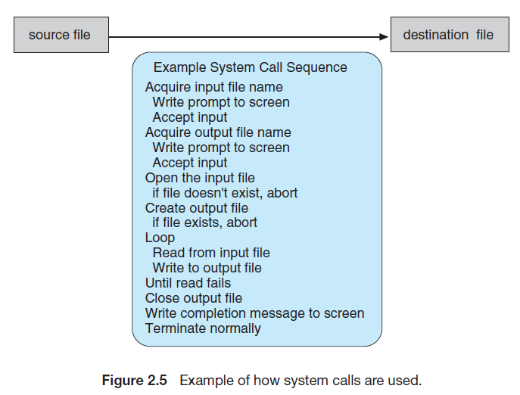
Finally, after the entire file is copied, the program may close both files (another system call), write a message to the console or window (more system calls), and finally terminate normally (the final system call).
This system-call sequence is shown in Figure 2.5.

Slide 67
As you can see, even simple programs may make heavy use of the operating system. Frequently, systems execute thousands of system calls per second.
Typically, application developers design programs according to an application programming interface (API).
The API specifies a set of functions that are available to an application programmer, including the parameters that are passed to each function and the return values the programmer can expect.
Three of the most common APIs available to application programmers are theWindows API for Windows systems, the POSIX API for POSIX-based systems (which include virtually all versions of UNIX, Linux, andMac OSX), and the Java API for programs that run on the Java virtual machine.
A programmer accesses an API via a library of code provided by the operating system. In the case of UNIX and Linux for programs written in the C language, the library is called libc.
Each operating system has its own name for each system call.

Slide 68
Behind the scenes, the functions that make up an API typically invoke the actual system calls on behalf of the application programmer.
For example, the Windows function CreateProcess() (which unsurprisingly is used to create a new process) actually invokes the NTCreateProcess() system call in the Windows kernel.
Why would an application programmer prefer programming according to an API rather than invoking actual system calls?
There are several reasons for doing so. One benefit concerns program portability.
An application programmer designing a program using an API can expect her program to compile and run on any system that supports the same API (although, in reality, architectural differences often make this more difficult than it may appear).
Furthermore, actual system calls can often be more detailed and difficult to work with than the API available to an application programmer.
Nevertheless, there often exists a strong correlation between a function in the API and its associated system call within the kernel. In fact, many of the POSIX and Windows APIs are similar to the native system calls provided by the UNIX, Linux, and Windows operating systems.

Slide 69
For most programming languages, the run-time support system (a set of functions built into libraries included with a compiler) provides a systemcall interface that serves as the link to system calls made available by the operating system.
The system-call interface intercepts function calls in the API and invokes the necessary system calls within the operating system. Typically, a number is associated with each system call, and the system-call interface maintains a table indexed according to these numbers.
The system call interface then invokes the intended system call in the operating-system kernel and returns the status of the system call and any return values.
The caller need know nothing about how the system call is implemented or what it does during execution. Rather, the caller need only obey the API and understand what the operating system will do as a result of the execution of that system call.
Thus, most of the details of the operating-system interface are hidden from the programmer by the API and are managed by the run-time support library.
The relationship between an API, the system-call interface, and the operating system is shown in Figure 2.6, which illustrates how the operating system handles a user application invoking the open() system call.

Slide 70
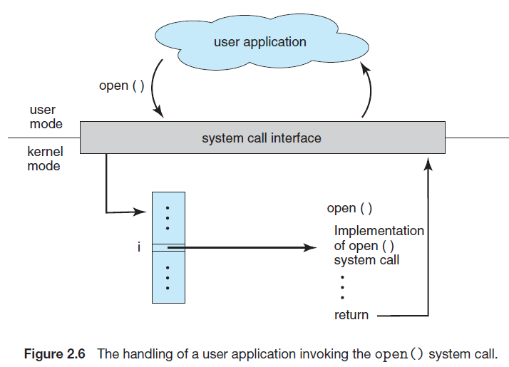

Slide 71
System calls occur in different ways, depending on the computer in use.
Often, more information is required than simply the identity of the desired system call.
The exact type and amount of information vary according to the particular operating system and call.
For example, to get input, we may need to specify the file or device to use as the source, as well as the address and length of the memory buffer into which the input should be read.
Of course,the device or file and length may be implicit in the call.

Slide 72
Three general methods are used to pass parameters to the operating system.
The simplest approach is to pass the parameters in registers. In some cases, however, there may be more parameters than registers.
In these cases, the parameters are generally stored in a block, or table, in memory, and the address of the block is passed as a parameter in a register (Figure 2.7).
This is the approach taken by Linux and Solaris. Parameters also can be placed,
or pushed, onto the stack by the program and popped off the stack by the operating system.
Some operating systems prefer the block or stack method because those approaches do not limit the number or length of parameters being passed.

Slide 73
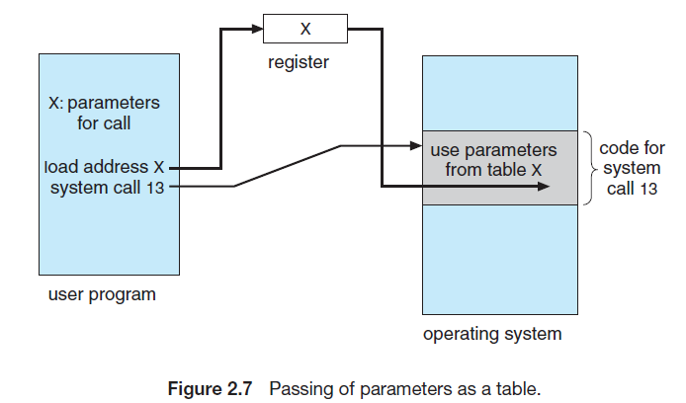

Slide 74
Types of System Calls
• Process control
◦ end, abort
◦ load, execute
◦ create process, terminate process
◦ get process attributes, set process attributes
◦ wait for time
◦ wait event, signal event
◦ allocate and free memory
• File management
◦ create file, delete file
◦ open, close
◦ read, write, reposition
◦ get file attributes, set file attributes

Slide 75
• Device management
◦ request device, release device
◦ read, write, reposition
◦ get device attributes, set device attributes
◦ logically attach or detach devices
• Information maintenance
◦ get time or date, set time or date
◦ get system data, set system data
◦ get process, file, or device attributes
◦ set process, file, or device attributes
• Communications
◦ create, delete communication connection
◦ send, receive messages
◦ transfer status information
◦ attach or detach remote devices

